Slide 1
Beat Extraction with Application to Robot Drumming
~
Michael Engstrom

Slide 2
Beat Extraction Goals
Design a robot that will play drums in rhythm to an audio source which is detected in the environment
A robot control board will move servos to make arms and legs pound drums to a beat
An input device will detect the audio, extract the beat, and send the information to the robot controller

Slide 3
Beat Extraction Phases
Software Design
Input of audio source
Beat detection
Output to robot controller
Mechanical Design
Arms and legs to beat drums
Interface to control software

Slide 4
Beat Detection
Tempo is complex

Slide 5
Beat Detection
Tempo is complex
Counterpoint, grouping, hierarchy are subtly combined and interpreted by the human ear

Slide 6
Beat Detection
Tempo is complex
Counterpoint, grouping, hierarchy are subtly combined and interpreted by the human ear
Beat (or pulse) is simpler

Slide 7
Beat Detection
Tempo is complex
Counterpoint, grouping, hierarchy are subtly combined and interpreted by the human ear
Beat (or pulse) is simpler
The sense of equally spaced temporal units (Handel, 1989)

Slide 8
Beat Detection
Tempo is complex
Counterpoint, grouping, hierarchy are subtly combined and interpreted by the human ear
Beat (or pulse) is simpler
The sense of equally spaced temporal units (Handel, 1989)
Detection using frequency decomposition

Slide 9
Beat Detection
Tempo is complex
Counterpoint, grouping, hierarchy are subtly combined and interpreted by the human ear
Beat (or pulse) is simpler
The sense of equally spaced temporal units (Handel, 1989)
Detection using frequency decomposition
Fourier Transforms can detect frequency power trends to determine the beat of an audio sample

Slide 10
Beat Detection
Audio input samples can be decomposed
Algorithm steps:
Frequency Filterbank
Envelope Extraction (Fourier Transform)
Differentiation
Rectification
Comb Filter (to match sample to known bpm)

Slide 11
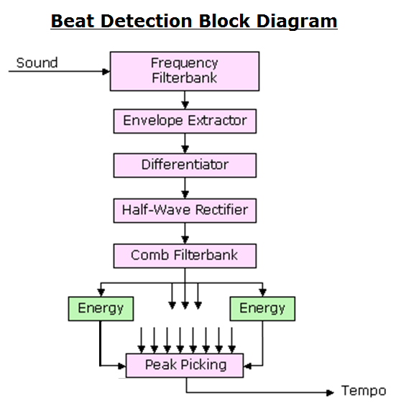

Slide 12
Beat Detection Algorithm
Step 1 – Frequency Filterbank

Slide 13
Beat Detection Algorithm
Step 1 – Frequency Filterbank
Split audio file into several frequency ranges
Similar instrument ranges can inhibit the detection of the beat

Slide 14
Beat Detection Algorithm
Step 1 – Frequency Filterbank
Split audio file into several frequency ranges
Similar instrument ranges can inhibit the detection of the beat
Allows for different instruments to be detected
0-200Hz, 200-400Hz, 400-800Hz, 800-1600Hz, 1600-3200Hz

Slide 15
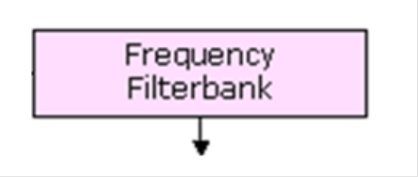
Beat Detection Algorithm
Step 1 – Frequency Filterbank
Each filter is implemented using a sixth-order elliptic filter

Slide 16
Beat Detection Algorithm
Step 1 – Frequency Filterbank
Each filter is implemented using a sixth-order elliptic filter
3 dB of ripple in the passband
40 dB of rejection in the stopband.

Slide 17
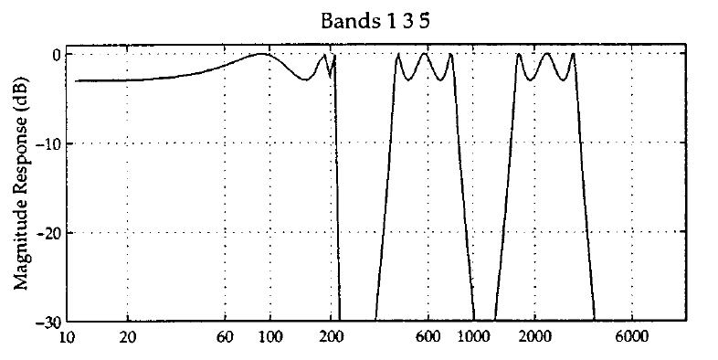
Beat Detection Algorithm
Step 1 – Frequency Filterbank

Slide 18
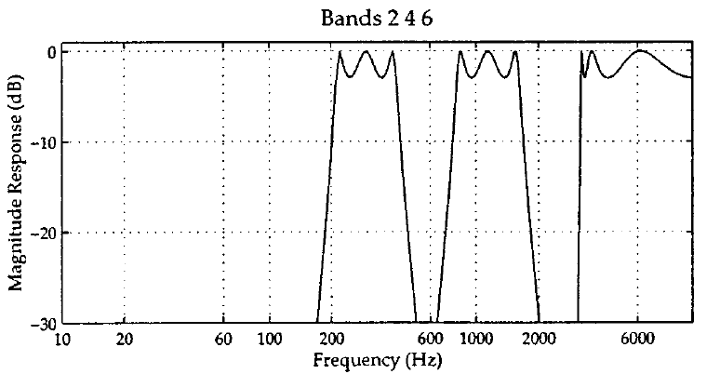
Beat Detection Algorithm
Step 1 – Frequency Filterbank

Slide 19
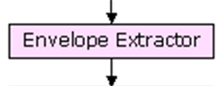
Beat Detection Algorithm
Step 2 – Envelope Extractor

Slide 20
Beat Detection Algorithm
Step 2 – Envelope Extractor
Filter each of the signal segments

Slide 21
Beat Detection Algorithm
Step 2 – Envelope Extractor
Filter each of the signal segments
Convert to Frequency Domain using FFT or DFT

Slide 22
Beat Detection Algorithm
Step 2 – Envelope Extractor
Filter each of the signal segments
Convert to Frequency Domain using FFT or DFT
Convolve and transform signal

Slide 23
Beat Detection Algorithm
Step 2 – Envelope Extractor
Filter each of the signal segments
Convert to Frequency Domain using FFT or DFT
Convolve and transform signal
Multiplication in Frequency Domain is the same as Convolution in the Time Domain

Slide 24
Beat Detection Algorithm
Step 2 – Envelope Extractor
Filter each of the signal segments
Convert to Frequency Domain using FFT or DFT
Convolve and transform signal
Multiplication in Frequency Domain is the same as Convolution in the Time Domain
Convert back to Time Domain

Slide 25
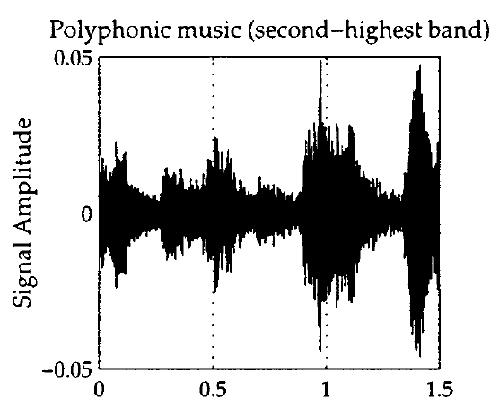
Beat Detection Algorithm
Step 2 – Envelope Extractor: Example

Slide 26
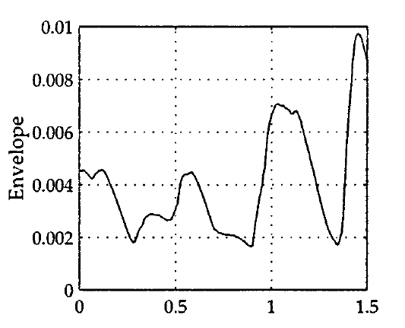
Beat Detection Algorithm
Step 2 – Envelope Extractor: Example

Slide 27
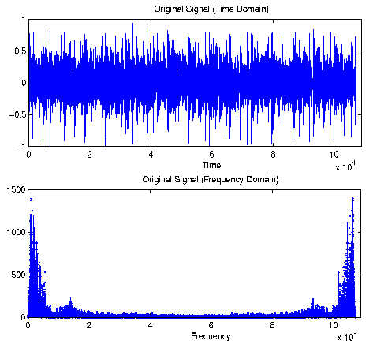
Fourier Transforms
Convert a signal from Time to Frequency Domain
Separates frequency and magnitude components

Slide 28
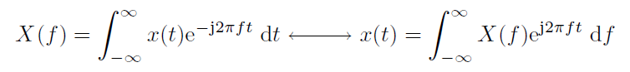
Fourier Transforms
Convert a signal from Time to Frequency Domain
Separates frequency and magnitude components
Fourier Transform Pair:

Slide 29
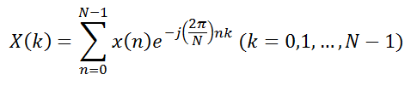
Fourier Transforms
Convert a signal from Time to Frequency Domain
Separates frequency and magnitude components
Fourier Transform Pair:
The Discrete Fourier Transform for digital signals:

Slide 30
Beat Detection Algorithm
Step 3 – Differentiate signal
Accentuate when the sound changes
Corresponds to beats
Step 4 – Rectify signal
Only see changes in sound
Signals ready to be analyzed

Slide 31
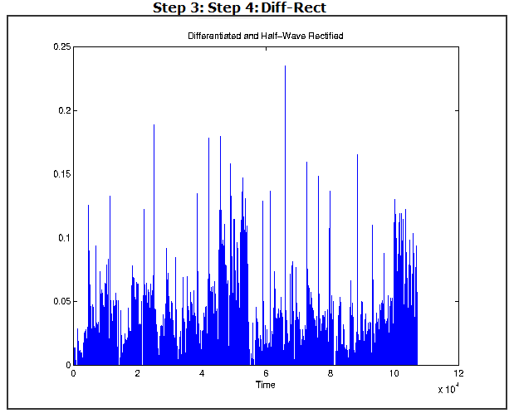
Beat Detection Algorithm

Slide 32
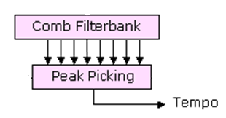
Beat Detection Algorithm
Step 5 – Comb Filter
Use various filters
Determine which has highest energy
Maximum value is the fundamental tempo

Slide 33
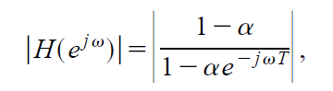
Beat Detection Algorithm
A Comb Filter is used to find tempo maxima
For delay T and gain α the magnitude response is

Slide 34
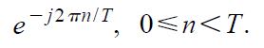
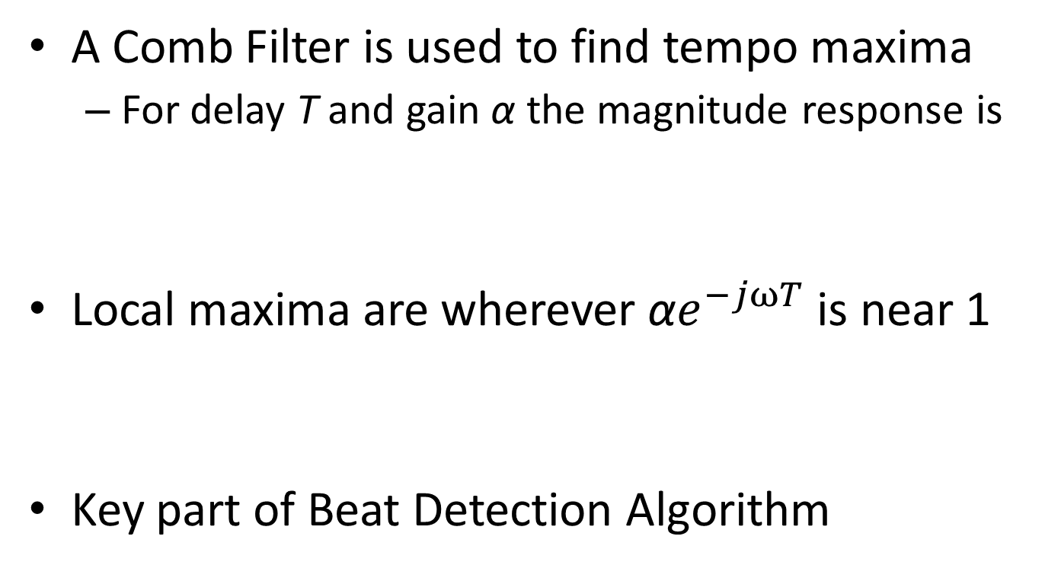
Beat Detection Algorithm
A Comb Filter is used to find tempo maxima
For delay T and gain α the magnitude response is
Local maxima are wherever ${\text{α}e}^{−jωT}$ is near 1
Key part of Beat Detection Algorithm

Slide 35
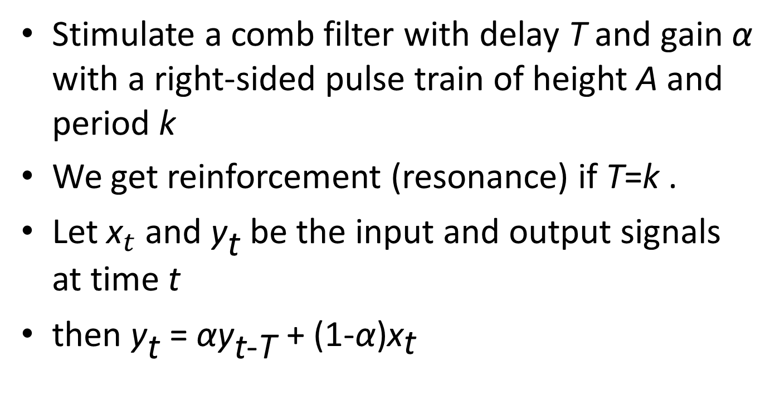
Beat Detection Algorithm
Stimulate a comb filter with delay T and gain α with a right-sided pulse train of height A and period k
We get reinforcement (resonance) if T=k .
Let ${\text{x}}_{t}$and ${\text{y}}_{\text{t}}$ be the input and output signals at time t
then ${\text{y}}_{\text{t}}$ = ${\text{α}\text{y}}_{\text{t}\text{−}\text{T}}$ + (1-α)${\text{x}}_{\text{t}}$

Slide 36
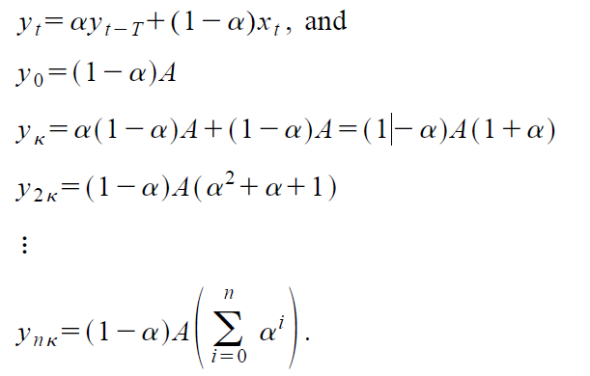
Beat Detection Algorithm

Slide 37
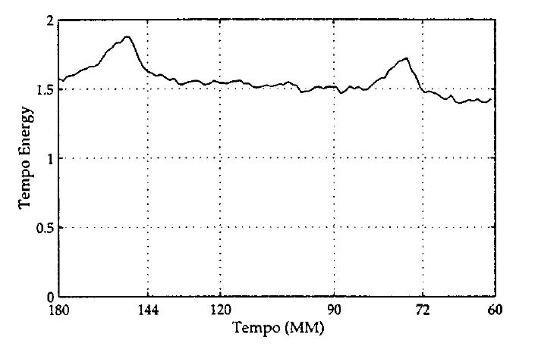
Beat Detection Algorithm
Energy is higher at dominant tempos

Slide 38
Software Design – Host Side
Matlab
Input audio from file or microphone
.wav file or 10 seconds of microphone sample
Follow Handel Algorithm in Matlab
Result is BPM value
Send BPM control value using Serial connection to Robot Controller

Slide 39
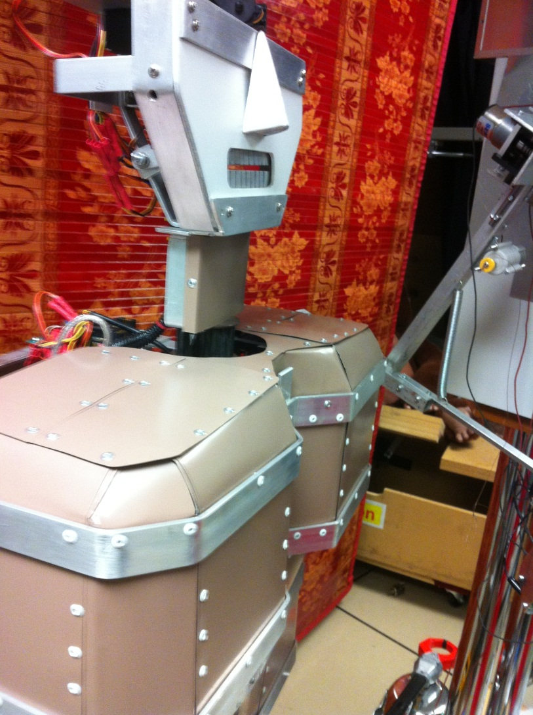
The ‘DIM’ Robot

Slide 40
Robot Design
Mechanical
Arms and legs to beat drums
Using lamps, casters and servos
3 degrees of freedom per arm
Software
Pololu Robot Controller
Interface to control software
Input Serial BPM data
Move robot limbs to drum at BPM

Slide 41
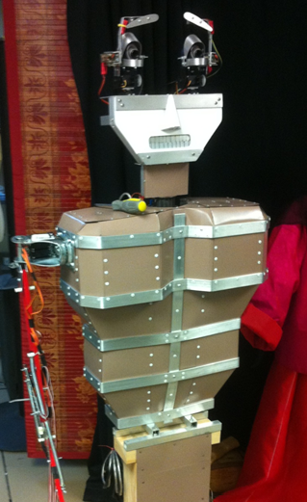
Robot - Mechanical Design

Slide 42
Robot - Mechanical Design
Added limbs to the DIM robot (as seen in the Robot Theater window)
Used servos to move limbs
A Pololu ‘Orangutan SVP’ robot controller handles the servo movement

Slide 43
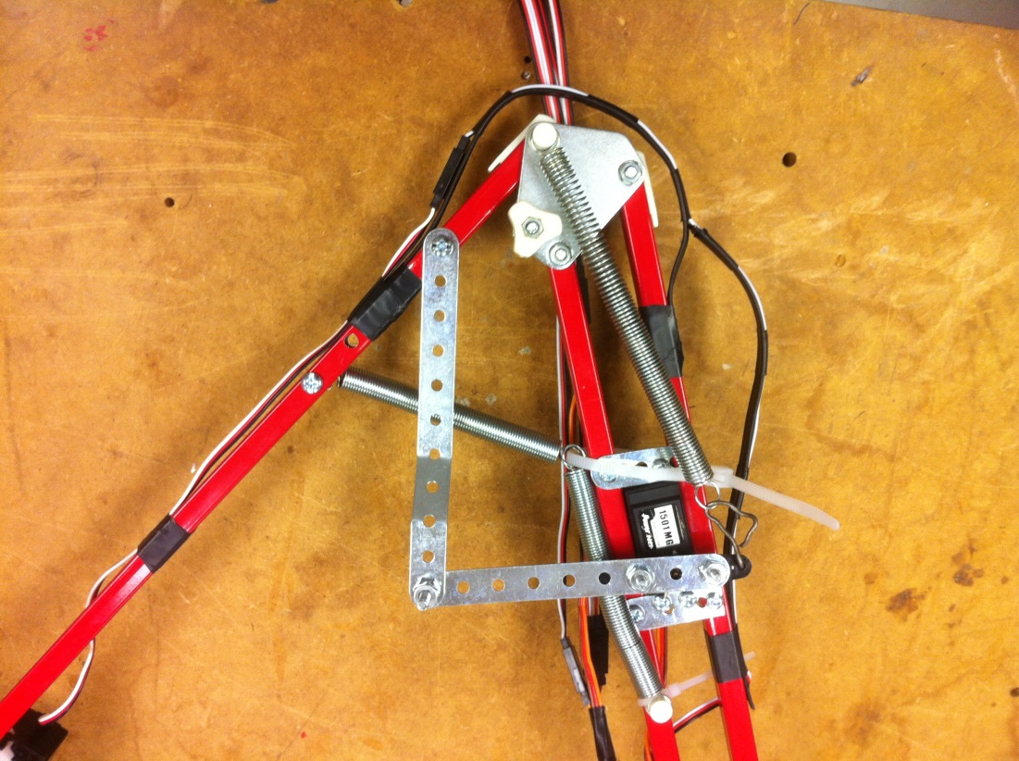
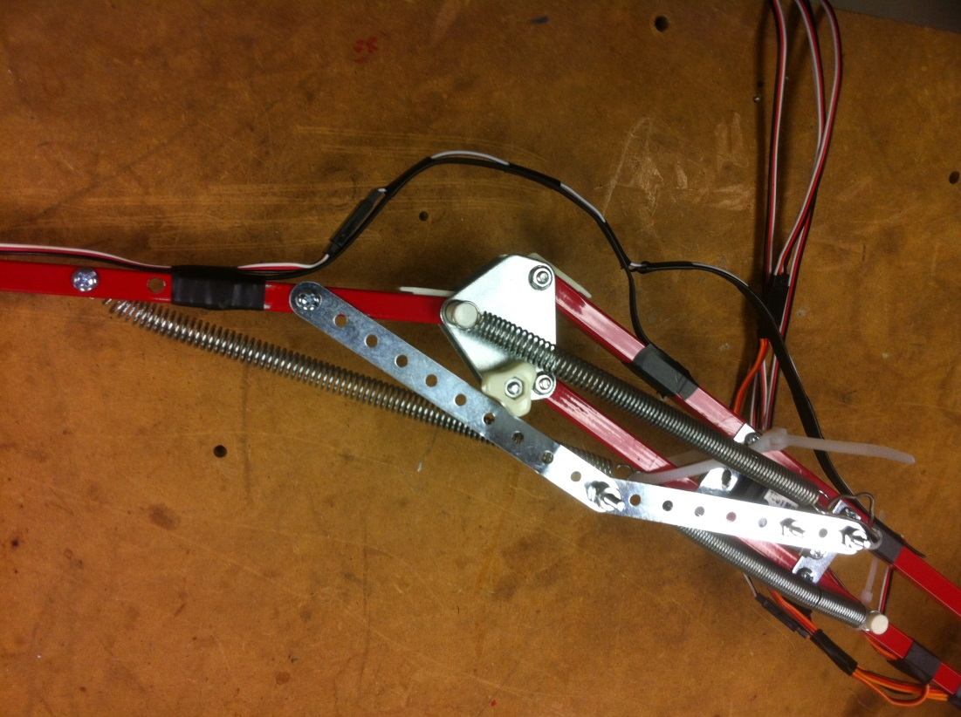
Robot - Mechanical Design
Arms
Lamp arm from thrift store
Servo moves arm indirectly

Slide 44
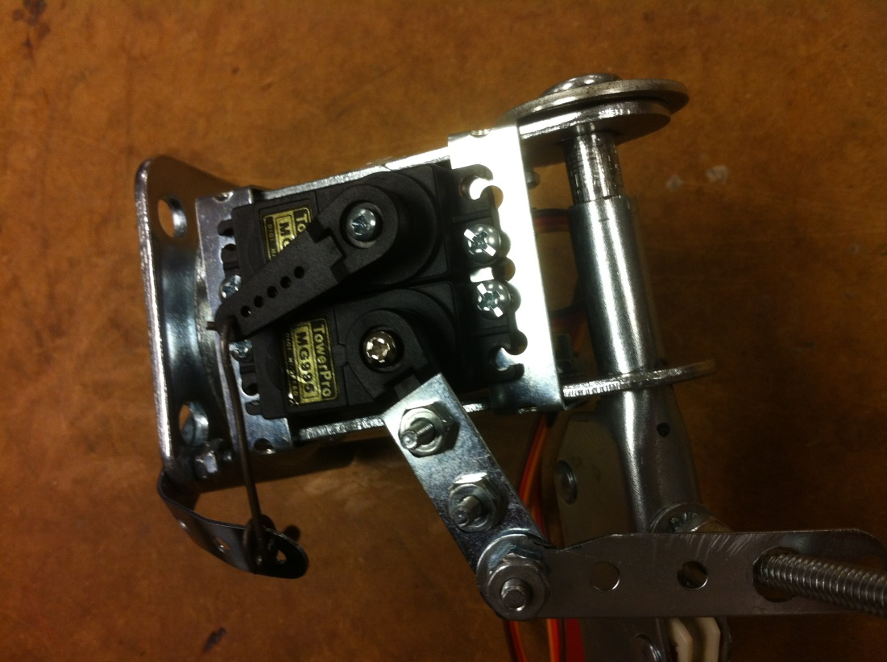
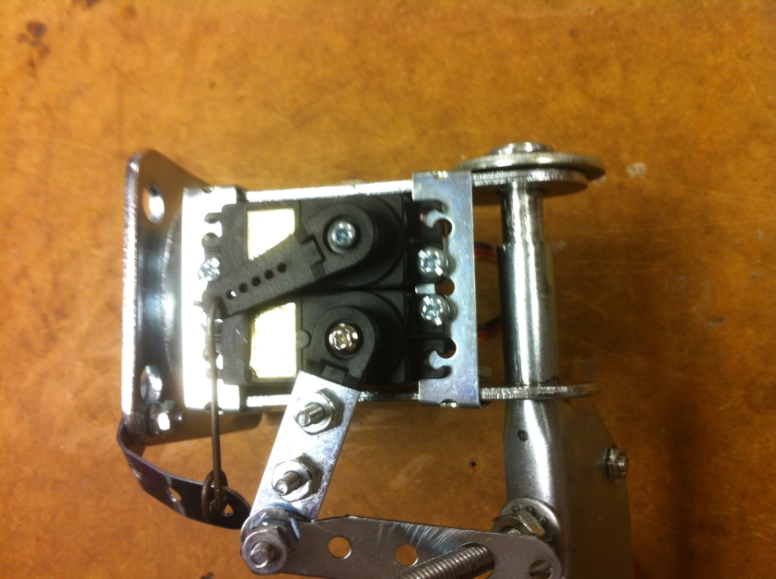
Robot - Mechanical Design
Arms
Shoulder made from caster wheel

Slide 45
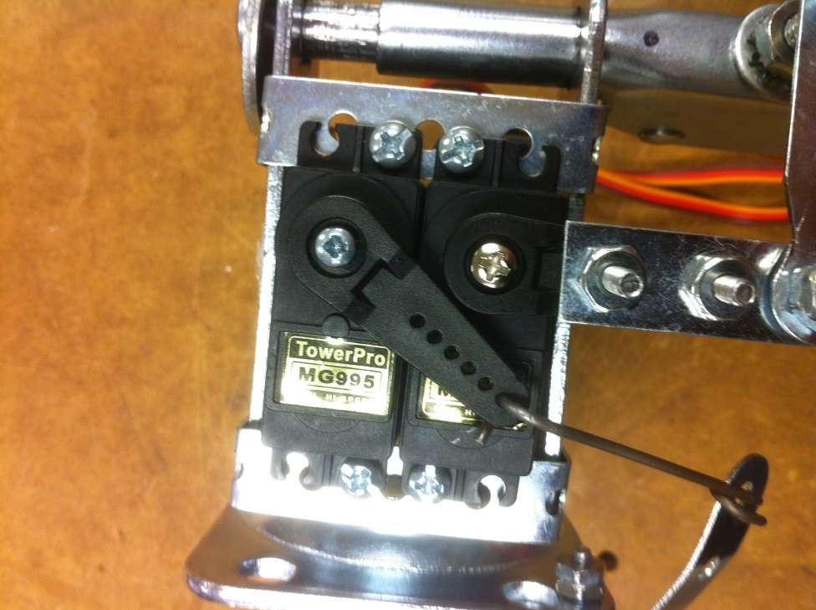
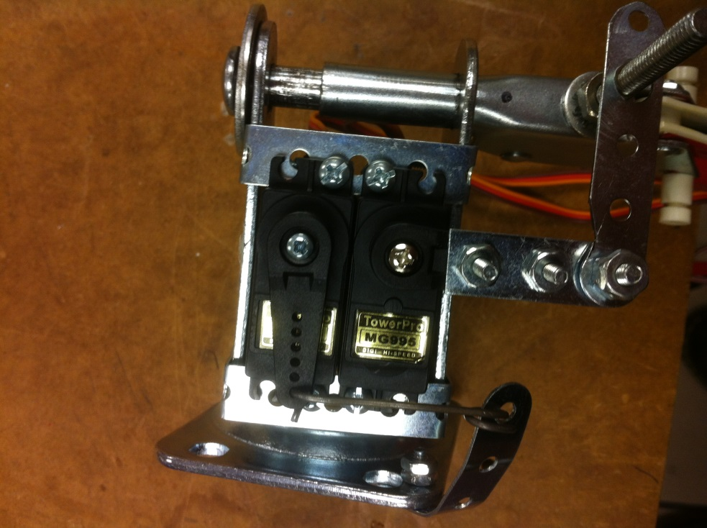
Robot - Mechanical Design
Arms
Shoulder made from caster wheel

Slide 46
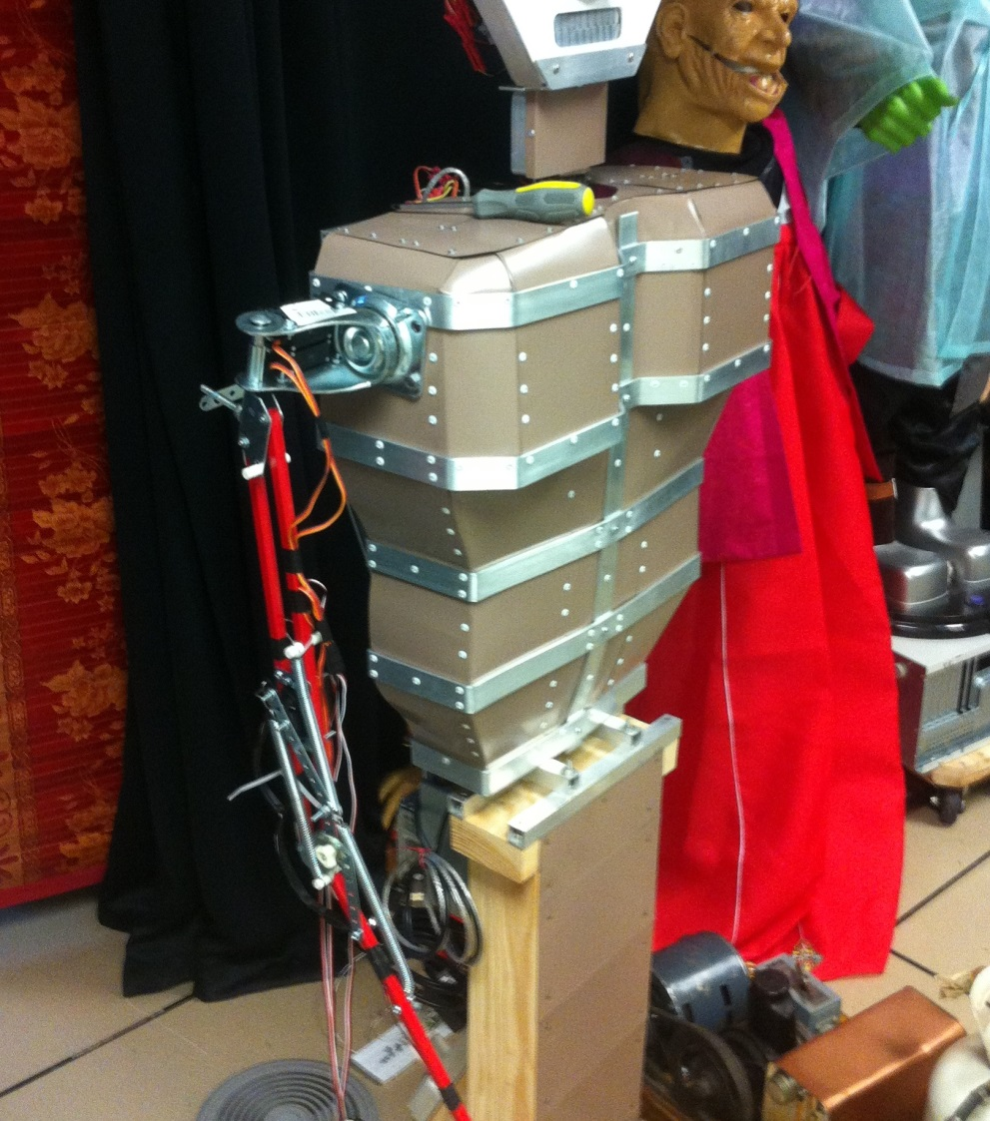
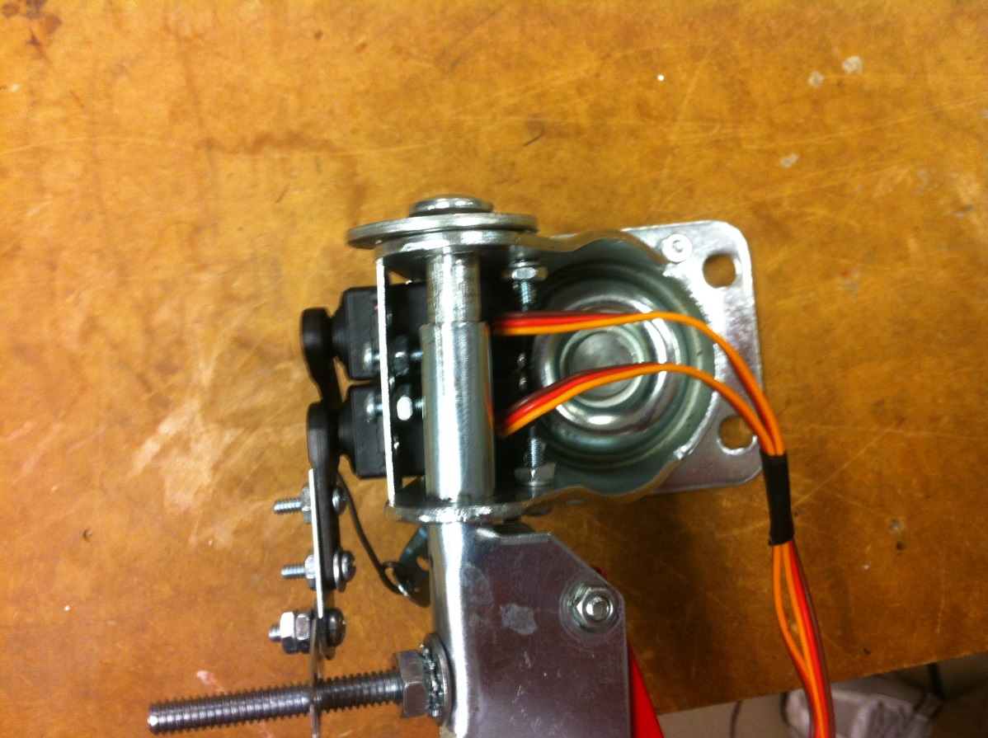
Robot - Mechanical Design
Completed Arms
Mounted on Robot torso

Slide 47
Robot - Software Design
Serial interface to Orangutan board
BPM and control information from Host

Slide 48
Robot - Software Design
Serial interface to Orangutan board
BPM and control information from Host
Output drumming movement in time with BPM
Changes BPM of drumming every time new serial BPM data is received

Slide 49
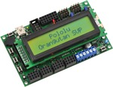
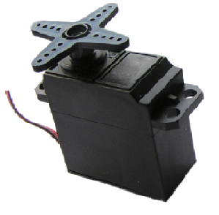
The Pololu Orangutan SVP Servo Controller

Slide 50
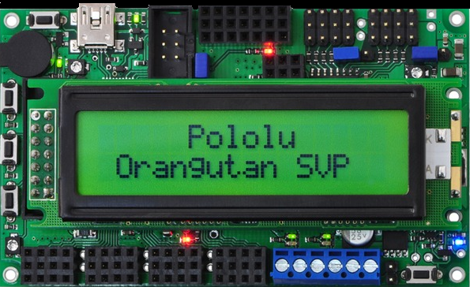
Orangutan SVP from Pololu

Slide 51
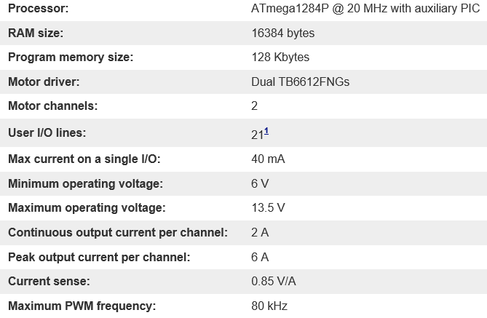
Orangutan Specifications

Slide 52
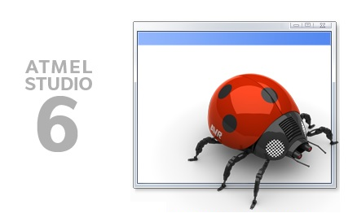
Atmel Orangutan Programming
Atmel Studio Development Software
Program the Orangutan in C code
APIs available for servos, LEDs, serial data, etc.

Slide 53
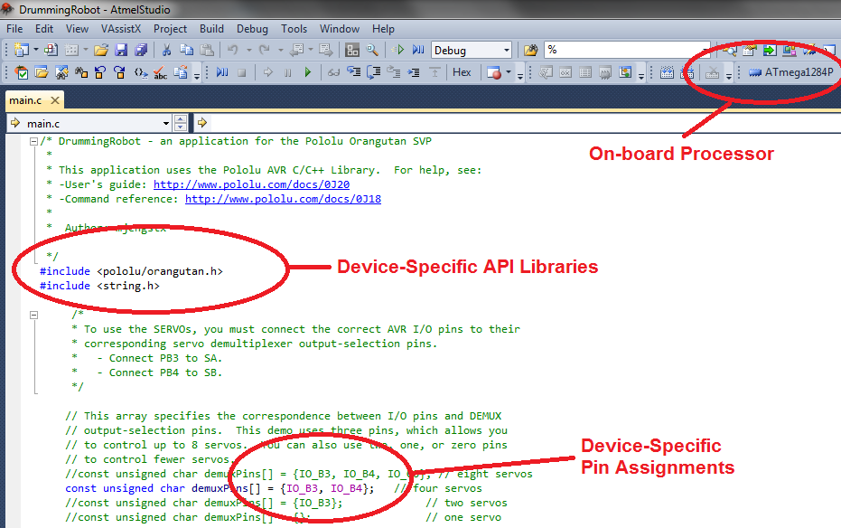
Atmel Orangutan Programming

Slide 54
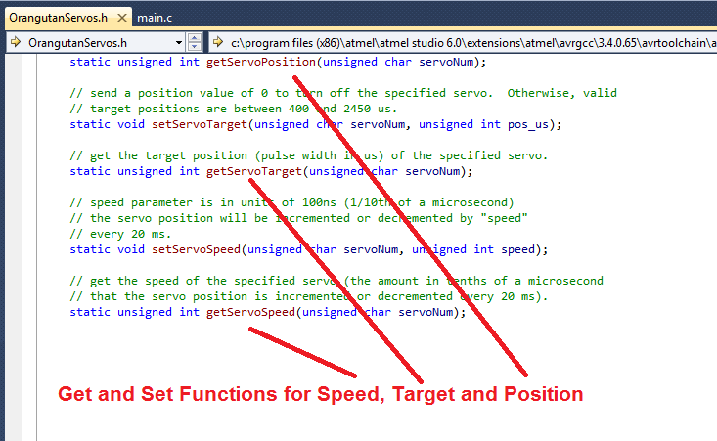
Atmel Orangutan Programming

Slide 55
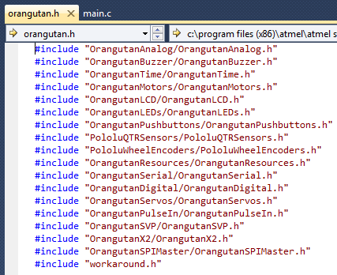
Atmel Orangutan Programming

Slide 56
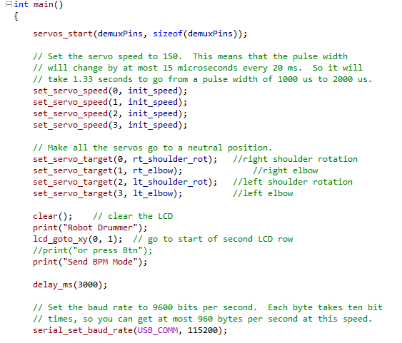
Orangutan Implemented Functions

Slide 57
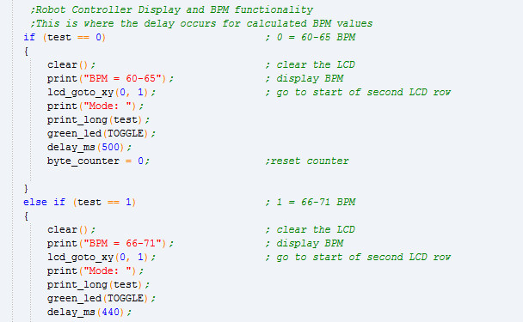
Drumming State Machine Code Initial [0,9] byte Implemenation

Slide 58
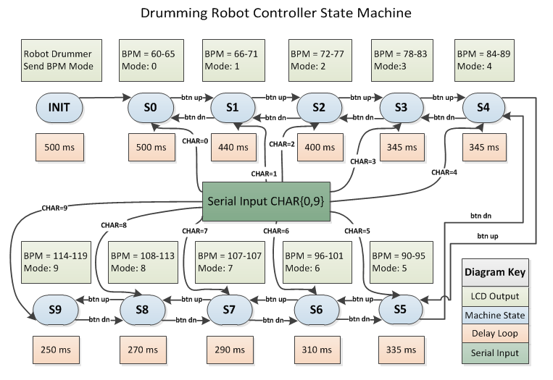
Drumming State Machine Code Initial [0,9] byte Implemenation

Slide 59
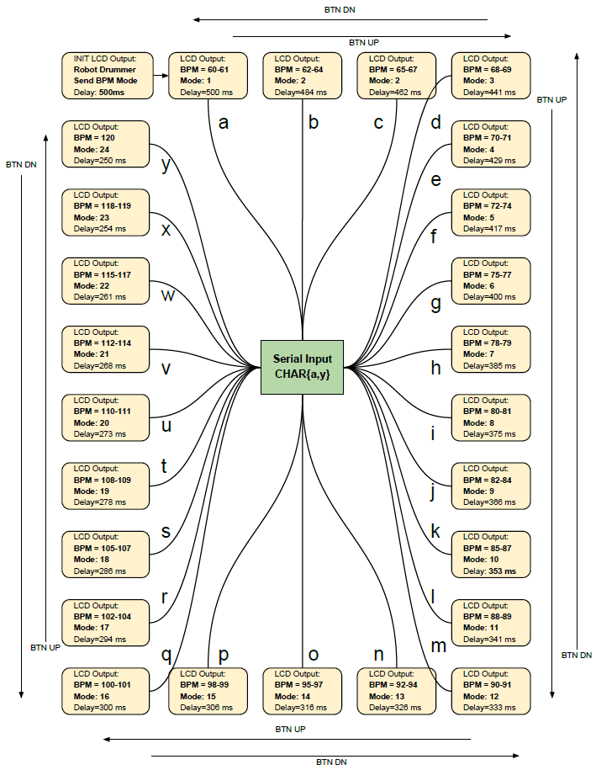
Drumming State Machine Code Improved [a,z] byte Implemenation

Slide 60
Videos
Drumming Robot Video Examples
Drumming Robot Host Side
Drumming Robot Controller

Slide 61
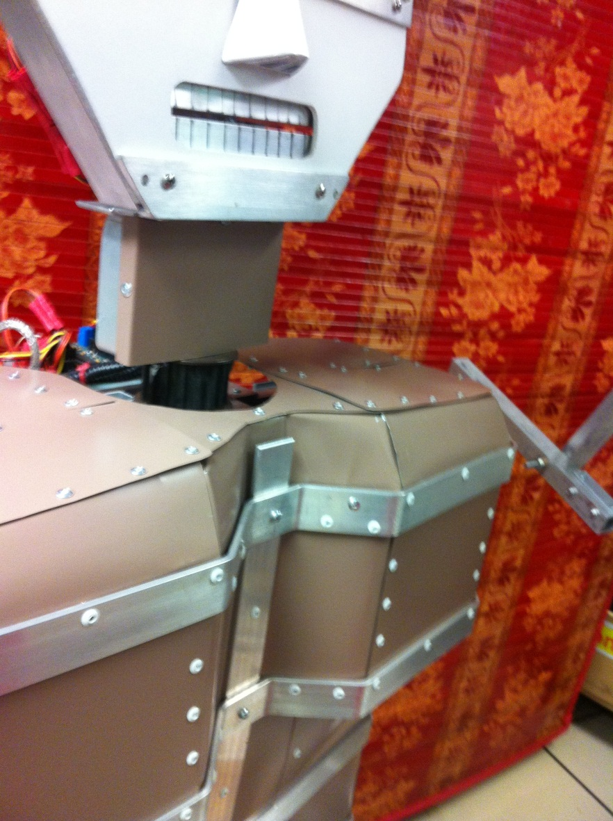
Questions?

Slide 62
References
Scheirer, Eric D. (1997). Tempo and beat analysis of acoustic musical signals. MIT Media Laboratory.
Cheng, Kileen; Nazer, Bobak; Uppuluri, Jyoti; Verret, Ryan (2001). Beat This – A Beat Synchronization Project. Rice University.
Handel, Stephen (1989). Listening. MIT Press.
Large, Edward W. and Kolen, John F. (1994). Resonance and the Perception of Musical Meter. Connection Science, Vol. 6, Nos. 2 & 3, p. 177.
Afonso, Valtino X.; Thompkins, Willis J.; Nguyen, Truong Q.; Luo, Shen (1999). ECG Beat Detection Using Filter Banks. IEEE Transactions on Biomedical Engineering, Vol. 46, No. 2.
Povel, Dirk-Jan and Essens, Peter (1985). Perception of Temporal Patterns. Music Perception: An Interdisciplinary Journal, Vol. 2, No. 4.
Jackson, Preston A.; Chan, Cy P.; Scalera, Jonathan E.; Rader, Charles M.; Vai, Michael (2004). A Systolic FFT Architecture for Real Time FPGA Systems. MIT Lincoln Laboratory.
Buso, Vincent (2012). VLSI Report. Illinois Institute of Technology.
Gerez, Sabih H. (2013). Hardware Implementations of the Fast Fourier Transform (FFT). University of Twente, The Netherlands.
Meyer-Baese, U. (2007). Digital Signal Processing with Field Programmable Gate Arrays. Springer.
Witte, Robert A. (2014). Spectrum and Network Measurements. SciTech.
Smith, Steven W. (2011). The Scientist and Engineer’s Guide to Digital Signal Processing. California Technical Publishing.
McKinney, Martin F. and Breebaart, Jeroen (2003). Features for Audio and Music Classification. Johns Hopkins University.
Lu, Li; Jiang, Hao; Zhang, HongJiang (2001). A Robust Audio Classification and Segmentation Method. ACM Multimedia.
O’Haver, Tom (2016). A Pragmatic Introduction to Signal Processing. University of Maryland at College Park.
Davies, Matthew E. P. and Plumbley, Mark D. (2006). A Spectral Difference Approach to Downbeat Extraction in Musical Audio. University of London Center for Digital Music.
Farid, Hany and Simoncelli, Eero P. (2004). Differentiation of Discrete Multi-Dimensional Signals. IEEE Transactions on Image Processing, Vol. 20, No. 20.

